Slide 1
Telecom Customer Churn Analysis & Prediction
By Vince Coletti

Slide 2
The Problem
How do we reduce customer churn to increase revenue?
Notes:
What are the key indicators of customer churn where at-risk customers can be identified so customer retention & marketing resources can be deployed more effectively to reduce churn by 20% next quarter?

Slide 3
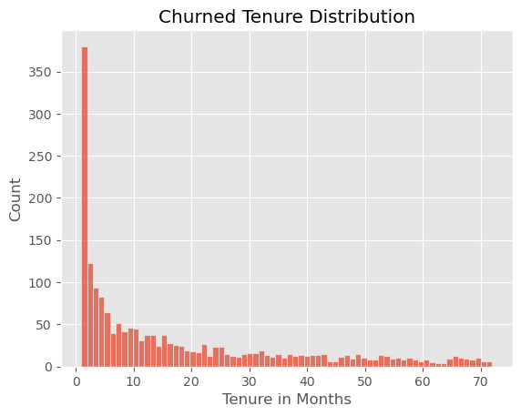
The Solutions
1) Reinforce customer’s purchasing decision as soon as they sign up.
Notes:
More customers churn after only 1 month than at any other point so much more effort needs to be put into reinforcing the customer's decision to do business with us during that first month. If that's all we did, we would see a very large decrease in churn.

Slide 4
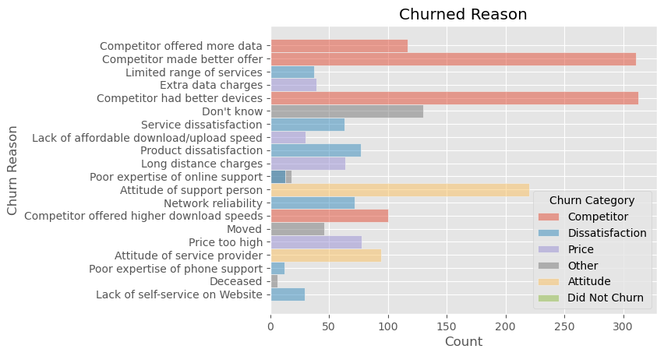
The Solutions
2) Improve some of our offerings, improve pricing, and improve customer support training.
Notes:
2) The top three reasons why customers churn are Competitor had better devices, Competitor made better offer, and attitude of the support person so we can address our offerings and improve training of customer support.

Slide 5
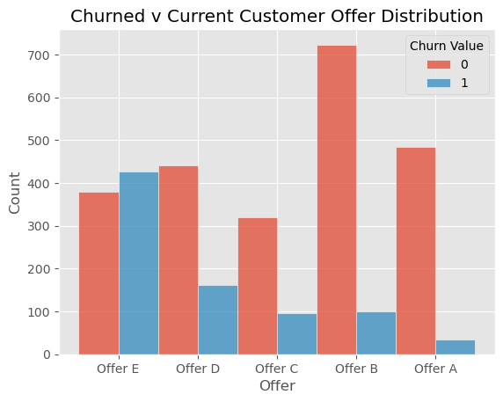
The Solutions
3) Phase out Offer E immediately.
Notes:
3) The offer that a customer signs up with has a great effect on whether the customer will churn or not. With Offers A & B, customers overwhelmingly stay with the company while more people churn when signed up with Offer E than stay. Ending offer E and putting more promotion into Offers A & B should greatly reduce churn.

Slide 6
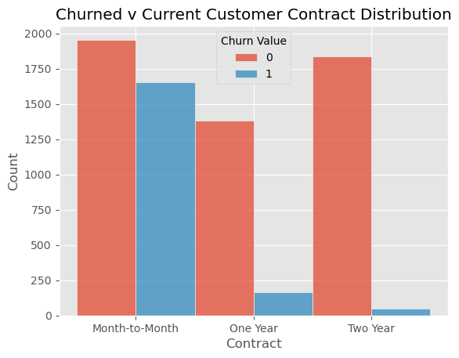
The Solutions
4) Incentivize customers to sign up for 1-2 year contracts instead of month to month.
Notes:
4) The distribution of contract type shows that customers that sign up with 1 or 2 year contracts rarely churn while customers on month to month contracts churn almost as much as they stay. Adding incentives to get customers to sign 1 or 2 year contracts, possibly being done in conjunction with offering Offer A or B, should also reduce churn substantially.

Slide 7
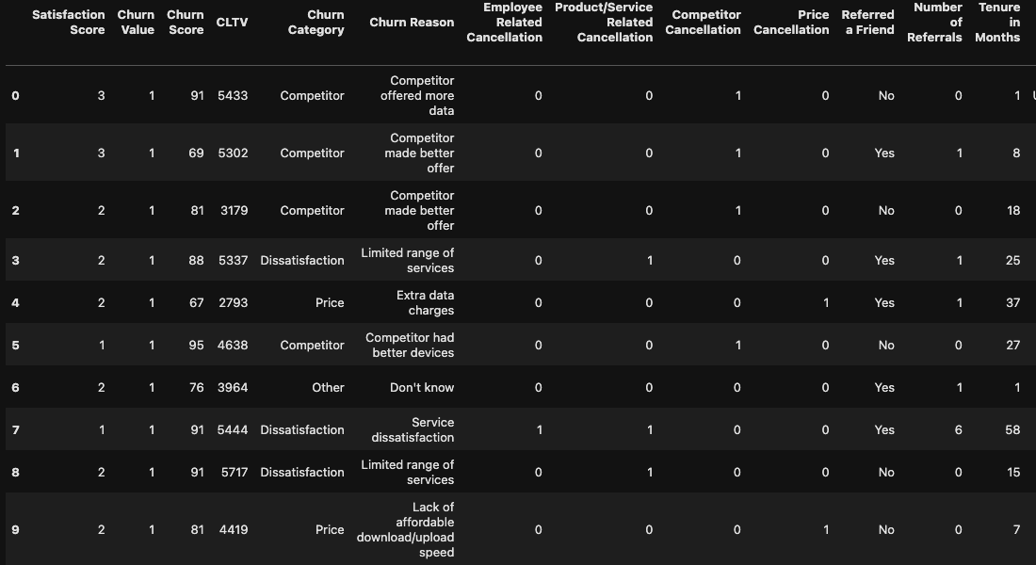
The Data
Data Source: https://community.ibm.com/community/user/businessanalytics/blogs/steven-macko/2019/07/11/telco-customer-churn-1113
Notes:
The data was sourced from IBM and came in the form of 5 different tables that needed to be joined and cleaned.

Slide 8
Data Cleaning
Original dataset came in 4 different Excel files, had 7,043 rows, and 62 columns. Most of the data was categorical, and there were missing values.
Joined tables
Missing values were handled appropriately
Dropped columns that provided no further information.
'Zip Codes' values were converted to strings to ensure that any potential leading 0's were not dropped.
Our target variable is naturally ‘Churn Value’ as that is what we are trying to predict.
Notes:
Values were missing from the tables for various reasons.
'Churn Category' & 'Churn Reason' missing values were because the rest of the observations did not churn so filled missing values for these columns to 'Did Not Churn'
'Offer' missing values were filled with 'Unknown/None'
After inspecting which customers had internet service, I found that the missing values in 'Internet Type' was due to those customers not receiving internet services from Telco. Filled missing values with 'None'.
'Count' & 'Quarter' columns were dropped as all values were 1 & Q3 respectively and provide no further value to this analysis.
'Lat Long', 'Latitude', & 'Longitude' columns were dropped. We already have State, City, & Zip. For our analysis, coordinate data is not beneficial.

Slide 9
Exploratory Data Analysis
Notes:
I looked at a number of different features and the relationships between them, and the most relevant data, that actually has actionable insights, are represented in these plots that I showed earlier.

Slide 10
Data Preprocessing
One hot encoding
Drop churn reason & churn category features
Split the data
Scale the data
Principal Component Analysis
Undersampling
Notes:
One hot encoded all categorical variables so the model knows how to use them
Although useful in EDA I had to drop all columns with churn categories or churn reasons to avoid data leakage as we would not have this information prior to a customer churning.
Split the data into our features and target variable then used 80% to train the model and 20% to test it
Used MinMaxScaler to scale the data to a common scale of 0 to 1 so the model doesn’t mistakenly put more weight on one feature over another simply because the scales are different
After one hot encoding and dropping the columns to avoid data leakage, there were still 48 features. I ran PCA and determined that 22 principal components accounted for 90% of the variance.
As our classes are imbalance, I undersampled from the majority to avoid the machine learning models from become biased towards predicting the majority class.

Slide 11
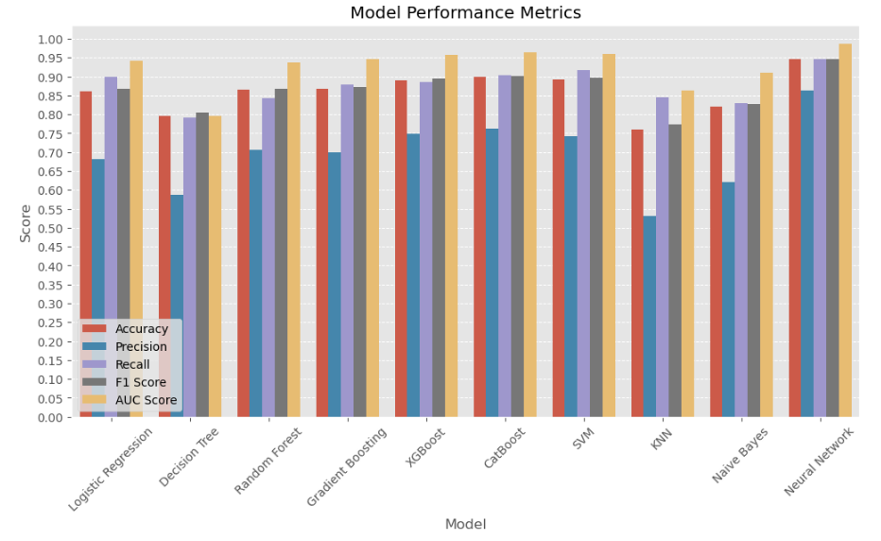
Initial Modeling
Notes:
I started by defining a few functions to make it faster and easier to test multiple models, cross validate the, and score them. I defined a modeling and scoring function, a model cross validation function, and ROC Curve function.
I then ran a for loop to test, cross validate, and score 10 different models at once using the functions i defined earlier. These are the scoring results of each of those 10 models.
In this use case we care most about accuracy and recall as we can do with misclassifying a customer who will not churn as one who will, but we can't do anything to try to stop a customer from churning if we can't identify them in the first place by misclassifying them as not churning.
The 3 models that I chose to move forward in hyperparameter tuning were the Logistic Regression Model, SVM, & Neural Network.

Slide 12
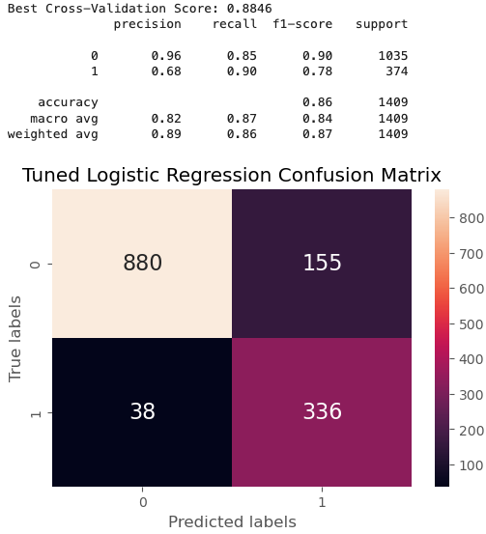
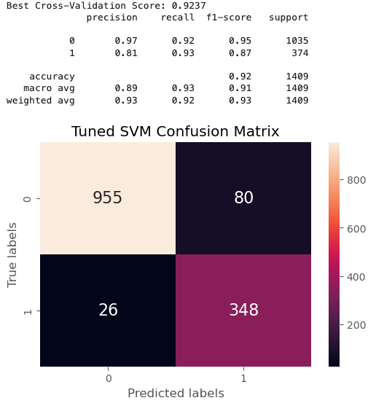
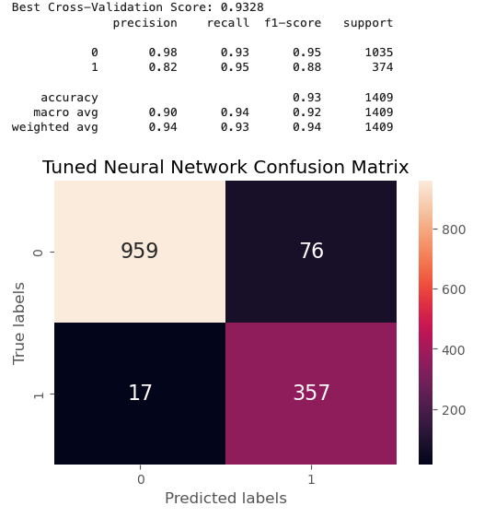
Model Hyperparameter Tuning
Logistic Regression
Accuracy: 86%
Recall: 90%
SVM
Accuracy: 92%
Recall: 93%
Neural Network
Accuracy: 93%
Recall: 95%
Notes:
Tuned hyperparameters using GridSearchCV for Logistic Regression and SVM, and RandomizedSearchCV for Neural Network as GridSearchCV took over 2 hours to run and there was minimal loss using RandomizedSearchCV

Slide 13
93% Accuracy
Neural Network Prediction Scoring
95% Recall

Slide 14
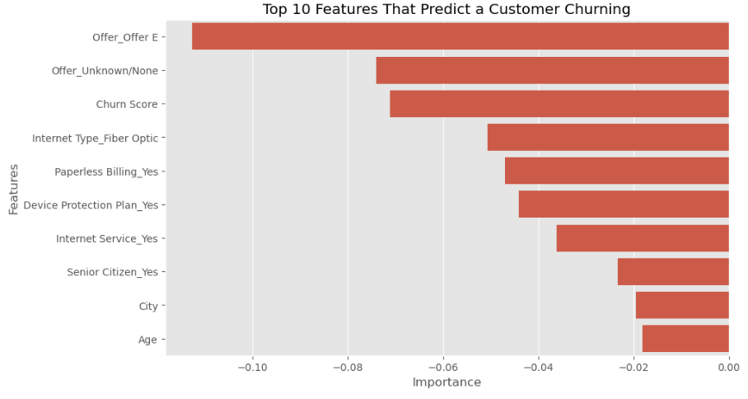
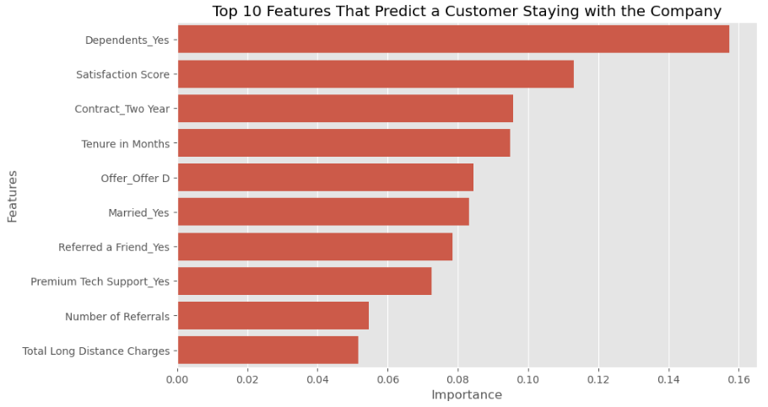
What makes a churned customer vs. a loyal one?

Slide 15
Future Research
After making recommended changes, collect more data to confirm if churn decreases and how the models change.
Collect more survey data from loyal customers to see why they say they remain with the company.
For competitor related churn reasons, it would be useful to know what exactly the competitor offered that was better than our offering and/or which competitor devices the customer switched because of.

Slide 16
Questions?

